Slide 1
Windows Security
InfraGard Jacksonville
CyberCamp
June 12, 2018

Slide 2

About Me
Over 12 years of progressive DevSecOps experience with a standards-based foundation rooted in automation and Systems Security Engineering (SSE). Hands-on, end-to-end information security leader built two “Gold Standard” federal security programs that produced 10+ federally certified systems. This includes tasks from pre-sales proposal work, policy and reference architecture development, requirements decomposition into agile sprints, proof of concepts, implementation, operations, and technical training to incident response.
Mentored/taught Windows and Linux security at CyberPatriot/CyberCamps since 2013. Accomplishments include 1st and 2nd in State and 1st in Regionals.
As a CSO for a federal SaaS, leads end-to-end Security, Privacy, and Operations for a FedRAMP Moderate (325 NIST 800-53r4 security controls) authorized SaaS hosted in AWS GovCloud.
Ricky Payne
CISSP, RHCE, RHCSA
Security+, BS-IST, AS-CET
grep.rickp@gmail.com
@RickPayne929

Slide 3
Course Overview
Windows Security:
Access Control - Account Management
Access Control - Account Lockout Policy
Auditing
Firewall
Identification and Authentication - Password Policy
Least Functionality – Features, Services, Sharing
Patching – Application, System
Prohibited file identification
Ricky Payne CISSP, RHCE, RHCSA, Security+ , BS-IST, AS-CET

Slide 4
Security Frameworks
The core of this lesson is centered around critical security concepts required in nearly every control framework. Examples include: NIST CSF, ISO 27002, ASD Top 35, NSA Top 10, PCI DSS, HIPAA¹…
Access Control - Account Management
NIST 800-53r5 Access Control family: AC-6 Least Privilege - Employ the principle of least privilege, allowing only authorized accesses for users (or processes acting on behalf of users) which are necessary to accomplish assigned tasks in accordance with organizational missions and business functions².
Patching – Application, System
PCI DSS Requirement 6 Develop and maintain secure systems and applications: 6.2 - Ensure that all system components and software are protected from known vulnerabilities by installing applicable vendor-supplied security patches. Install critical security patches within one month of release³.

Slide 5
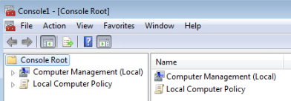
Management Console
Use MMC as a centralized means to manage Windows security.
Click: Start -> Type: mmc -> Open as administrator (Ctrl+Shift)
File -> Add/Remove Snap-in… (Ctrl+M)
Computer Management
Group Policy Object Editor

Slide 6
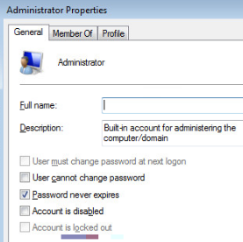
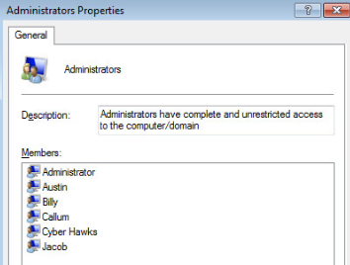
Access Control - Account Management
Per the Principle of Least Privilege (PoLP), consider what users are on the system and what access they have.
Expand Computer Management -> System Tools -> Local Users and Groups
Select: Users -> Review several users - > observe the General tab account attributes such as password expiration, disabled status, and group membership via the Member Of tab.
Select: Groups -> Review several Groups - > observe the members and the ability to add / remove.

Slide 7
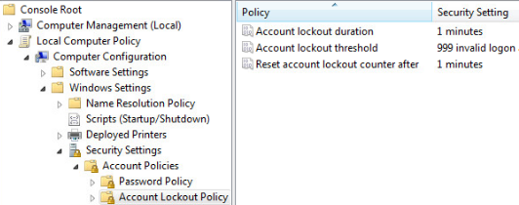
Access Control - Account Lockout Policy
The ALP can be configured to prevent brute-force attacks⁴.
Expand Local Computer Policy -> Computer Configuration -> Windows Settings -> Security Settings -> Account Policies -> Account Lockout Policy
Explore all 3 settings and the Explanation tab to understand each configuration.

Slide 8
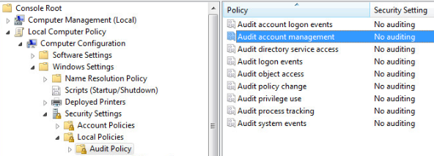
Auditing
Audit logs are necessary to provide a trail of evidence to help identify configuration errors, troubleshoot service disruptions, and analyze compromises that have occurred as well as detecting attacks⁴.
Expand Local Computer Policy -> Computer Configuration -> Windows Settings -> Security Settings -> Local Policies -> Audit Policy
Explore the auditing settings and the Explanation tab to understand each configuration.

Slide 9
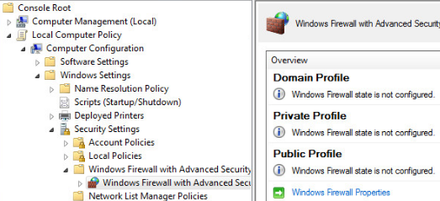
Firewall
A firewall provides a line of defense against attack, allowing or blocking inbound and outbound connections based on a set of rules⁴.
Expand Local Computer Policy -> Computer Configuration -> Windows Settings -> Security Settings -> Windows Firewall with Advanced Security
Explore the firewall properties to view various settings, such as on/off ang logging, for each Profile.

Slide 10
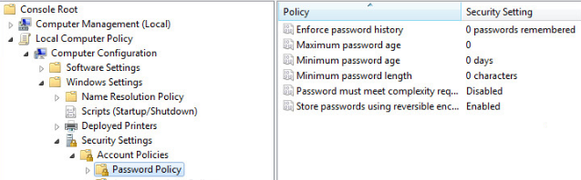
Identification and Authentication - Password Policy
Default credentials and weak passwords often lead to breaches and botnets. Creating a strong password policy can greatly reduce these risks.
Expand Local Computer Policy -> Computer Configuration -> Windows Settings -> Security Settings -> Account Policies -> Password Policy
Explore all 6 settings and the Explanation tab to understand each configuration.

Slide 11
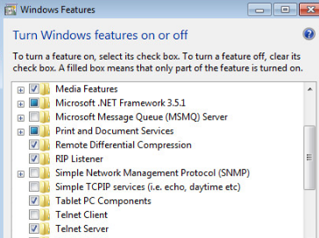
Least Functionality – Features
Systems provide a wide variety of functions and services. Some of the functions and services routinely provided by default, may not be necessary to support essential organizational missions, functions, or operations. Organizations consider disabling unused or unnecessary physical and logical ports and protocols to prevent unauthorized connection of devices, transfer of information, and tunneling².
Click: Start -> Type: Features -> Open Turn Windows features on or off
Review the enabled features for prohibited or unnecessary items such as Media Features and Telnet.

Slide 12
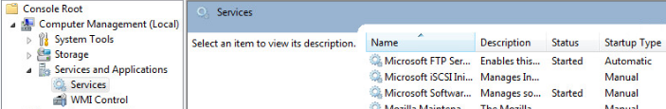
Least Functionality – Services
Systems provide a wide variety of functions and services. Some of the functions and services routinely provided by default, may not be necessary to support essential organizational missions, functions, or operations. Organizations consider disabling unused or unnecessary physical and logical ports and protocols to prevent unauthorized connection of devices, transfer of information, and tunneling².
Expand Computer Management -> Services and Applications -> Services
Review the services for prohibited or unnecessary items such as FTP and Telnet.

Slide 13
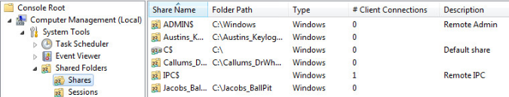
Least Functionality – Sharing
Uncontrolled resource sharing, such as Anonymous and Everyone, can lead to unauthorized system access, resource exposure, and/or corruption of sensitive data⁴.
Expand Computer Management -> System Tools -> Shared Folders -> Shares
Review each share for unnecessary or overly permissive shares.

Slide 14
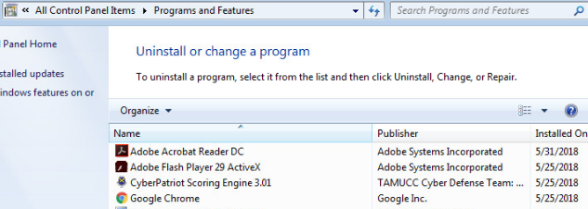
Patching – Application
Major software vendors release security patches and hot fixes to their products when security vulnerabilities are discovered. It is essential that these updates be applied in a timely manner to prevent unauthorized persons from exploiting identified vulnerabilities.⁴
Click: Start -> Type: Features -> Open Programs and Features
Review the installed applications for prohibited or unnecessary items such as additional browsers or supporting applications.
Ideally, these programs are removed; otherwise, follow vendor guidance on application patching.

Slide 15
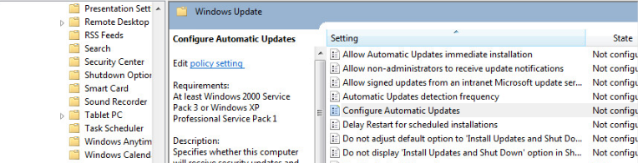
Patching – System
Major software vendors release security patches and hot fixes to their products when security vulnerabilities are discovered. It is essential that these updates be applied in a timely manner to prevent unauthorized persons from exploiting identified vulnerabilities.⁴
Expand Local Computer Policy -> Computer Configuration -> Administrative Templates -> Windows Components -> Windows Update
Review the settings and Explanation tabs to configure an automated patch installation policy.

Slide 16
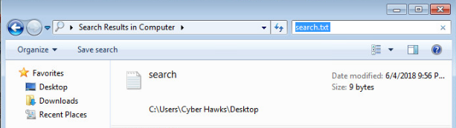
Prohibited file identification
Quick file location methods can aide in incident response, support malicious file identification, and help locate prohibited files.
Right Click: Desktop -> New (w) -> Text Document (t) -> Name: search.txt
Open search.txt -> Type: CyberCamp -> Save (Ctrl+s) and Close the file (Alt+F4)
On the Desktop -> Double click: Computer -> Type: “search.txt” in the Search Box

Slide 17
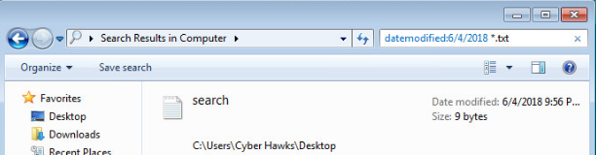
Prohibited file identification
Quick file location methods can aide in incident response, support malicious file identification, and help locate prohibited files.
On the Desktop -> Double click: Computer -> Type: “datemodified: <today’s date> *.txt” in the Search Box

Slide 18
References
CIS Critical Security Controls. SANS. Retrieved on June 4, 2018, from https://www.sans.org/security-resources/posters/20-critical-security- controls/55/download
NIST Special Publication 800-53 Revision 5. Security and Privacy Controls for Information Systems and Organizations. Retrieved on June 4, 2018, from https://csrc.nist.gov/CSRC/media//Publications/sp/800-53/rev- 5/draft/documents/sp800-53r5-draft.pdf
PCI DSS Prioritized Approach for PCI DSS 3.2. PCI Security Standards Council. Retrieved on June 4, 2018, from https://www.pcisecuritystandards.org/documents/Prioritized-Approach-for- PCI_DSS-v3_2.pdf
Windows 7 Security Technical Implementation Guide V1R30. DISA. Retrieved on June 4, 2018, from https://iase.disa.mil/stigs/sunset/Pages/index.aspx

